Slide 1
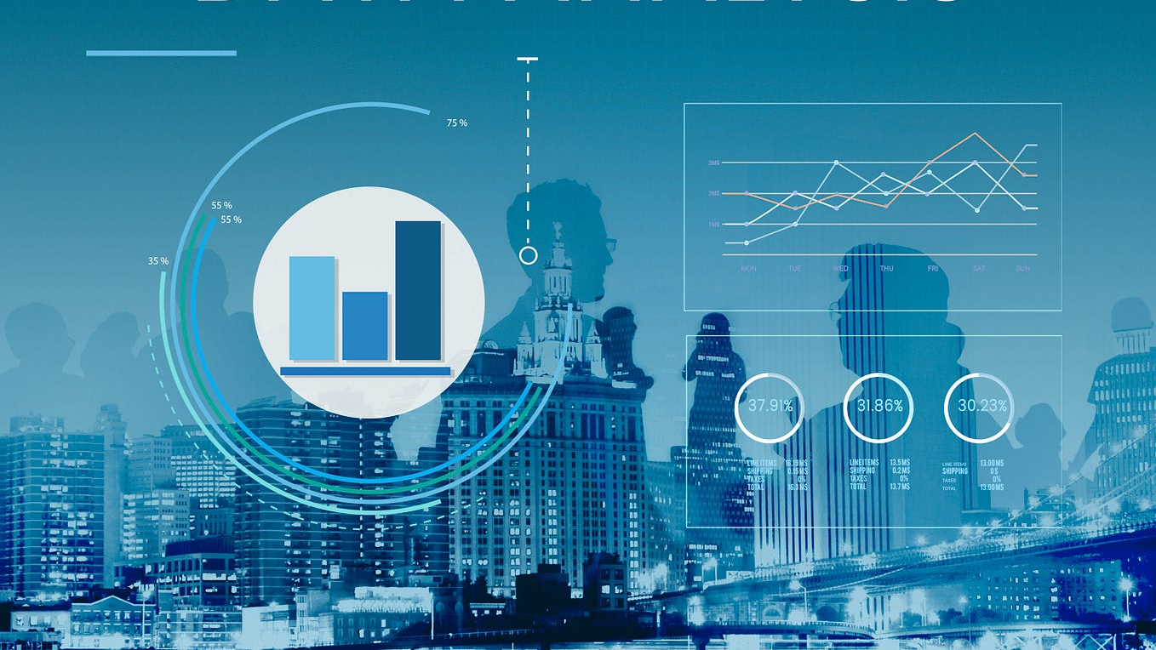
MATALE PETER MOLEPO
Oasis Infobyte

Slide 2
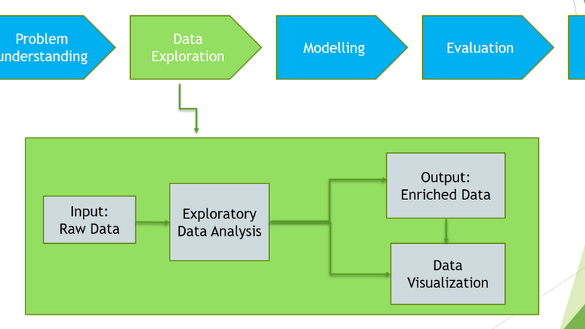
PROJECT 1 PROPOSAL LEVEL 1
Exploratory Data Analysis (EDA)
is a data treatment technique with the aim of describing the basics of a set with a view of producing summaries most of the time graphically. In data analysis process, it is a crucial phase to investigate the data, make hypothesis testing and assessments to discover anomalies or patterns using either statistical data and figures or data visualizations.

Slide 3

1. Data Loading and Cleaning
Load Data: Import necessary libraries and load the dataset into a Data Frame.
Check for Missing Values: Identify any missing values in each column and decide on a strategy for handling them (e.g., imputation or removal).
Validate Data Types: Ensure Date is in datetime format.
Ensure Customer ID, Transaction ID, SKU Category ID, and SKU ID are treated as categorical or string types as appropriate.
Ensure Quantity Sold and Sales Amount are numeric.
Handle Duplicates: Check for and remove any duplicate Transaction ID entries to ensure transaction uniqueness.
D. Verify Data Consistency: Ensure that Sales Amount equals Quantity Sold times the unit price.
Validate that Quantity Sold and Sales Amount are positive and realistic.
Outlier Detection and Treatment: Identify and handle any outliers in Quantity Sold and Sales Amount that may affect analysis.
E. Final Validation: Conduct a final review to ensure all data is clean and consistent.
Save the cleaned dataset for further analysis.

Slide 4

Retail Store Sales Transactions (Scanner Data)
Dataset Overview:
The dataset consists of 64,682 transactions, with stocks to value of 5,242 numbers of unique SKU and 22,625 unique customer in a year span.
This gave them the basis that would help determine the magnitude and nature of the data involved.

Slide 5

Retail Store Sales Transactions (Scanner Data)
Columns in the Dataset: Date: It is normally applied for dissecting the sale data and unique relation in successive periods to find out the sales velocity and time sales tendencies. Customer ID: Applied to determine the overall transactions per customers and to easily see who are the most active customers. Transaction ID: Ensured the non-recurrence of the given transaction. SKU Category ID: Assisted in the enhancement of the company’s understanding of the sales distribution with respect to various product types. SKU ID: It was used mainly for studying the sales trends and the number of products sold in the stores. Quantity Sold: Very useful in establishing the overall number of units of products sold and in assessing the sales’ volume aspect. Sales Amount: They were applied for basic revenue determination and average ticket calculations.

Slide 6
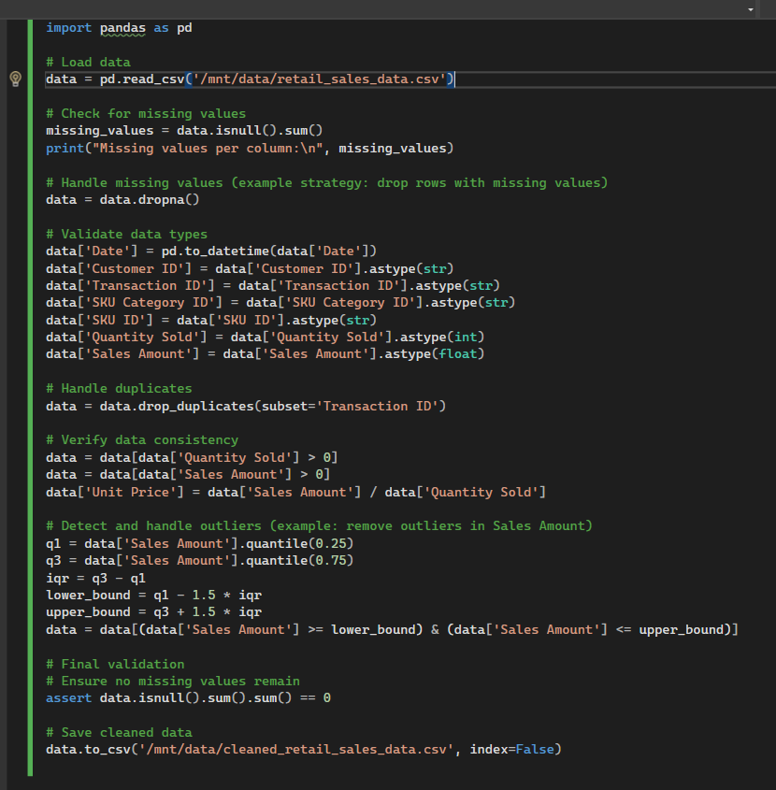

Slide 7
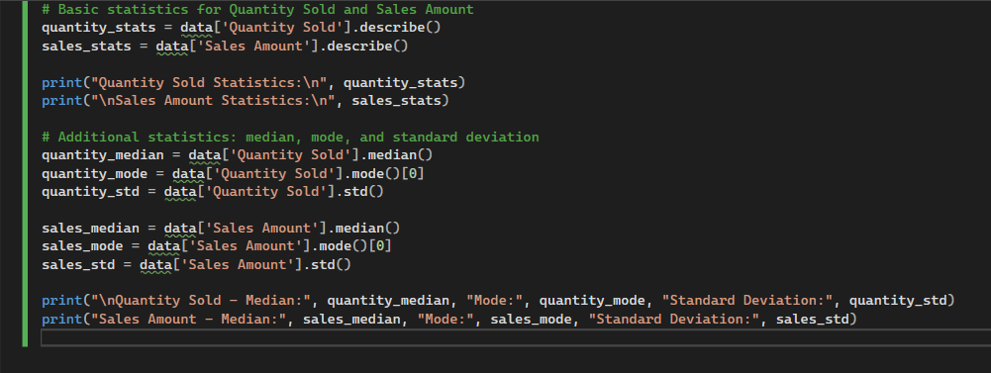
2. Descriptive Statistics
Calculate basic statistics for key columns such as Quantity Sold and Sales Amount.

Slide 8
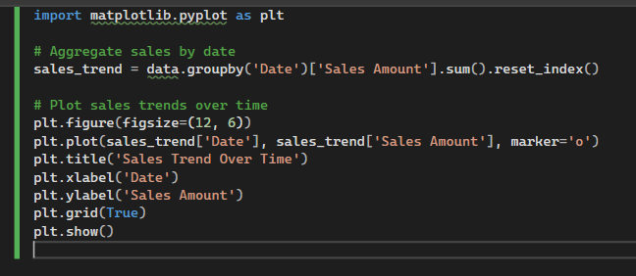
3. Time Series Analysis Analyse sales trends over time.

Slide 9
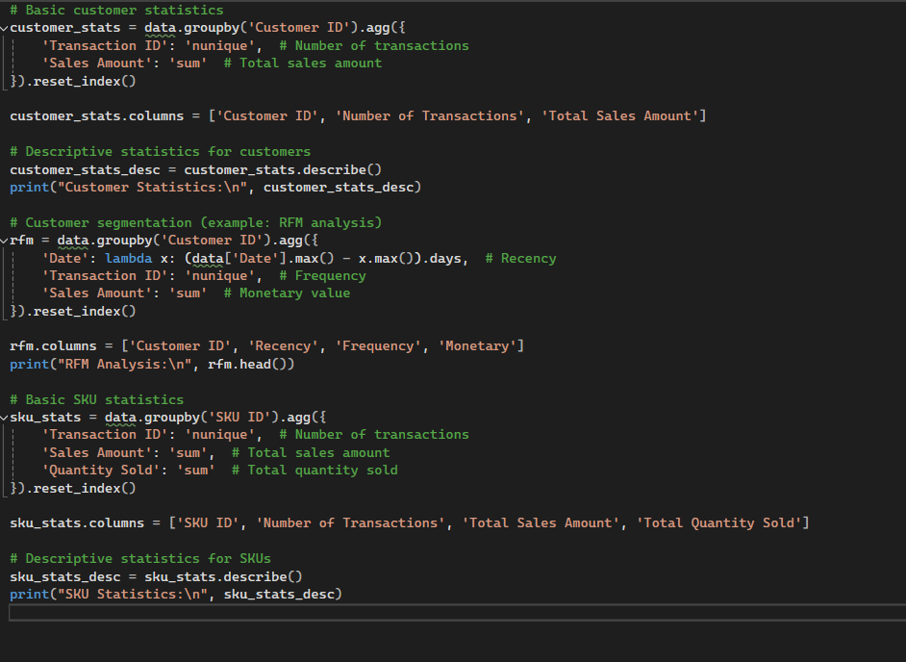
4. Customer and Product Analysis Customer Analysis AND Product Analysis:

Slide 10
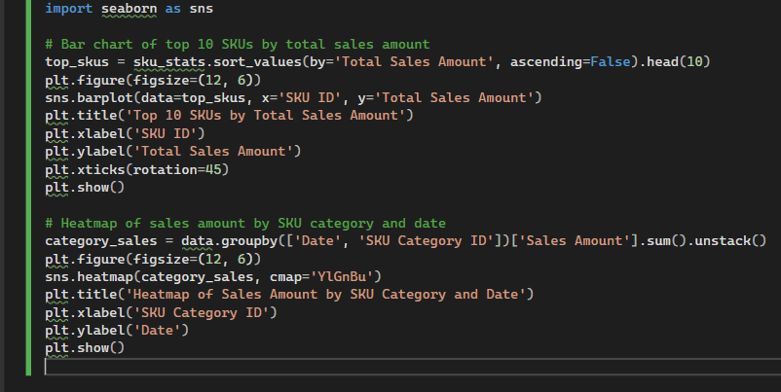
5. Visualization Present insights through bar charts, line plots, and heatmaps.

Slide 11

6. Recommendations Based on the EDA findings,
1. Identify Top-Performing Products: Market to the most popular products as they have the highest turnover rates or the ones with high demand.
- There should be better stock control on these products, perhaps we should order more to avoid getting out of stock.
2. Customer Segmentation and Targeting: The next step would involve the development of specific marketing techniques to be used on the customer segments that has been ascertained from the RFM analysis.
- This idea is to provide targeted promotions for patrons who often and who spend much money at the business to increase their loyalty.
3. Price Optimization: - Determine the relationship between the manner of price changes and the resulting effects on sales quantity with reference to appropriate pricing methods for various goods.
4. Seasonal Sales Strategies: Second, analyse the sales periods and time frequency and then make the promotional campaigns during the identified time periods.
- Goods for sale, as well as people, must be ready to cope with an increase in sales during these periods of time.
5. Improve Data Collection: It is also important to maintain high data quality by focusing on missing data in every step of the data collection process and minimizing data inconsistencies.
- It is important to also check from time to time the quality of the data you have collected in order to ensure they are accurate and credible.

